Slide 1


Chapter 4
Divide-and-Conquer
Copyright © 2007 Pearson Addison-Wesley. All rights reserved.

Slide 2
Divide-and-Conquer
The most-well known algorithm design strategy:
Divide instance of problem into two or more smaller instances
Solve smaller instances recursively
Obtain solution to original (larger) instance by combining these solutions

Slide 3
Divide-and-Conquer Technique (cont.)
a problem of size n
(instance)
subproblem 1
of size n/2
subproblem 2
of size n/2
a solution to
subproblem 1
a solution to
subproblem 2
a solution to
the original problem
It general leads to a recursive algorithm!

Slide 4
Divide-and-Conquer Examples
Sorting: mergesort and quicksort
Binary tree traversals
Binary search (?)
Multiplication of large integers
Matrix multiplication: Strassen’s algorithm
Closest-pair and convex-hull algorithms

Slide 5
General Divide-and-Conquer Recurrence
T(n) = aT(n/b) + f (n) where f(n) ∈ Θ(n^{d}), d ≥ 0
Master Theorem: If a < b^{d}, T(n) ∈ Θ(n^{d})
If a = b^{d}, T(n) ∈ Θ(n^{d} log n)
If a > b^{d}, T(n) ∈ Θ(n^{log b a} )
Note: The same results hold with O instead of Θ.
Examples: T(n) = 4T(n/2) + n ⇒ T(n) ∈ ?
T(n) = 4T(n/2) + n² ⇒ T(n) ∈ ?
T(n) = 4T(n/2) + n³ ⇒ T(n) ∈ ?
Θ(n^2)
Θ(n^2log n)
Θ(n^3)

Slide 6
Mergesort
Split array A[0..n-1] into about equal halves and make copies of each half in arrays B and C
Sort arrays B and C recursively
Merge sorted arrays B and C into array A as follows:
  Repeat the following until no elements remain in one of the arrays:
    compare the first elements in the remaining unprocessed portions of the arrays
    copy the smaller of the two into A, while incrementing the index indicating the unprocessed portion of that array
  Once all elements in one of the arrays are processed, copy the remaining unprocessed elements from the other array into A.

Slide 7
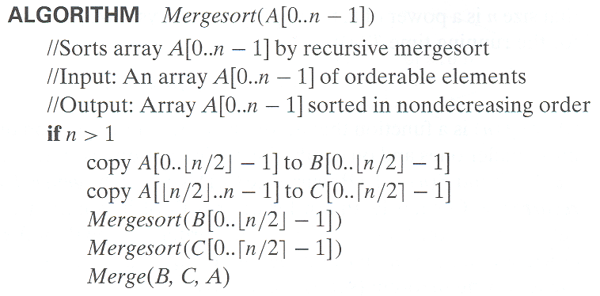
Pseudocode of Mergesort

Slide 8
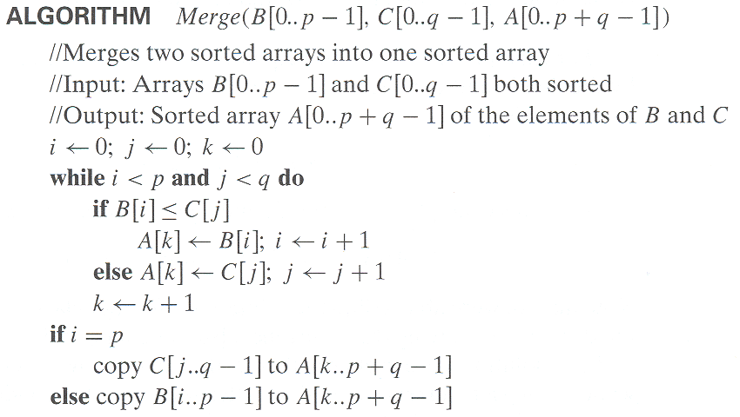
Pseudocode of Merge
Time complexity: Θ(p+q) = Θ(n) comparisons

Slide 9
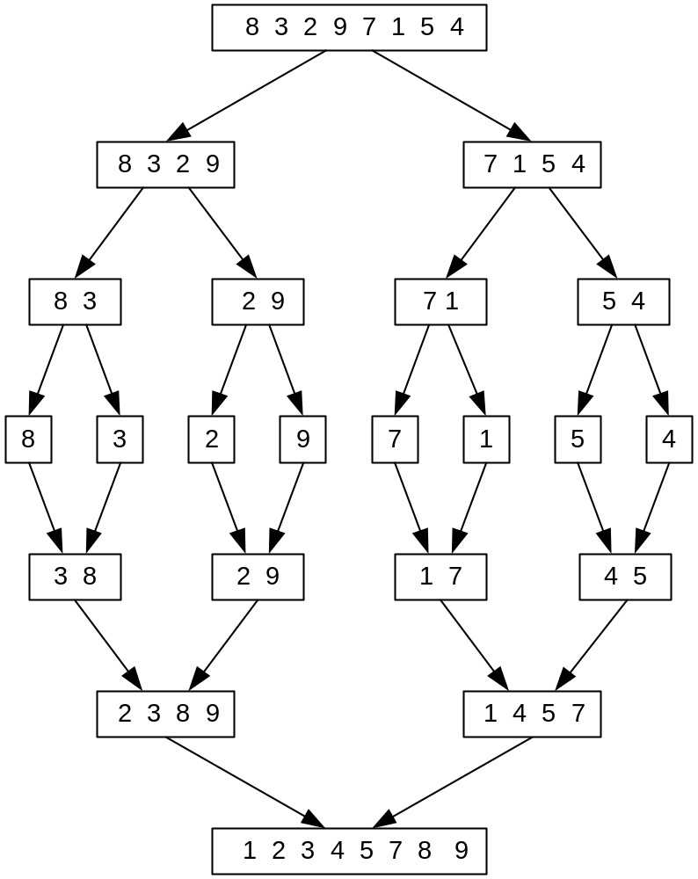
Mergesort Example
The non-recursive version of Mergesort starts from merging single elements into sorted pairs.
Notes:
Go over this example in detail, then do another example of merging, something like:
(1 2 5 7 9)
(3 4 6)

Slide 10
Analysis of Mergesort
All cases have same efficiency: Θ(n log n)
Number of comparisons in the worst case is close to theoretical minimum for comparison-based sorting:
  ⎡log₂ n!⎤ ≈ n log₂ n - 1.44n
Can be implemented without recursion (bottom-up)
T(n) = 2T(n/2) + Θ(n), T(1) = 0
Notes:
even if not analyzing in detail, show the recurrence for mergesort in worst case:
T(n) = 2 T(n/2) + (n-1)
worst case comparisons for merge

Slide 11
Quicksort
Select a pivot (partitioning element) – here, the first element
Rearrange the list so that all the elements in the first s positions are smaller than or equal to the pivot and all the elements in the remaining n-s positions are larger than or equal to the pivot (see next slide for an algorithm)
Exchange the pivot with the last element in the first (i.e., ≤) subarray — the pivot is now in its final position
Sort the two subarrays recursively
p
A[i]≤p
A[i]≥p

Slide 12
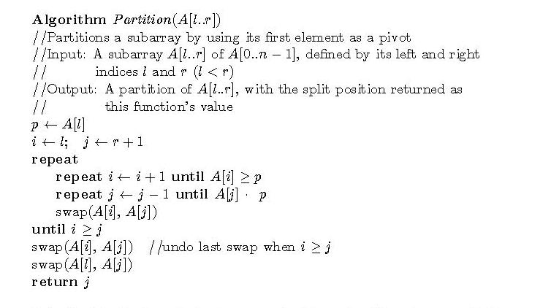
Partitioning Algorithm
or i > r
or j = l
<
Time complexity: Θ(r-l) comparisons

Slide 13
Quicksort Example
5 3 1 9 8 2 4 7
2 3 1 4 5 8 9 7
1 2 3 4 5 7 8 9
1 2 3 4 5 7 8 9
1 2 3 4 5 7 8 9
1 2 3 4 5 7 8 9

Slide 14
Analysis of Quicksort
Best case: split in the middle — Θ(n log n)
Worst case: sorted array! — Θ(n²)
Average case: random arrays — Θ(n log n)
Improvements:
  better pivot selection: median of three partitioning
  switch to insertion sort on small subfiles
  elimination of recursion
  These combine to 20-25% improvement
Considered the method of choice for internal sorting of large files (n ≥ 10000)
T(n) = T(n-1) + Θ(n)

Slide 15
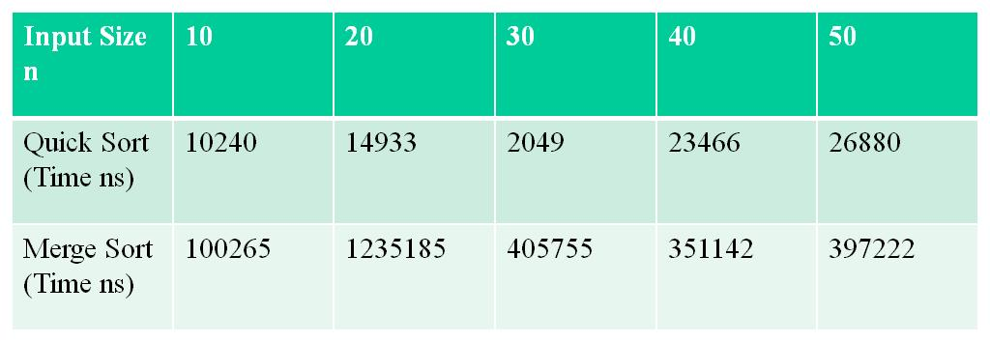
Computation Time for Different Size of Input
For smaller inputs quick sort perform better than the merge sort, due to the fact the merge sort is not in place unlike quick sort. We need more amount of space in case of merge sort.

Slide 16
Binary Search
Very efficient algorithm for searching in sorted array:
K
vs
A[0] . . . A[m] . . . A[n-1]
If K = A[m], stop (successful search); otherwise, continue
searching by the same method in A[0..m-1] if K < A[m]
and in A[m+1..n-1] if K > A[m]
l ← 0; r ← n-1
while l ≤ r do
m ← ⎣(l+r)/2⎦
if K = A[m] return m
else if K < A[m] r ← m-1
else l ← m+1
return -1

Slide 17
Analysis of Binary Search
Time efficiency
  worst-case recurrence: C_{w} (n) = 1 + C_{w}( ⎣n/2⎦ ), C_{w} (1) = 1
  solution: C_{w}(n) = ⎡log₂(n+1)⎤
  This is VERY fast: e.g., C_{w}(10⁶) = 20
Optimal for searching a sorted array
Limitations: must be a sorted array (not linked list)
Bad (degenerate) example of divide-and-conquer
because only one of the sub-instances is solved
Has a continuous counterpart called bisection method for solving equations in one unknown f(x) = 0 (see Sec. 12.4)

Slide 18
Binary Tree Algorithms
The efficiency is based on the comparisons and addition operations.
we should check whether the tree is empty or not. For an empty tree, the comparison T = ∅ is executed once but these are no additions.
For a single node tree, the comparison and addition numbers are 3 and 1 respectively.
The tree’s extension can be drawn by replacing the empty sub trees by special nodes which helps in analysis.
The extra nodes (square) are called external; the original nodes (circles) are called internal nodes.
The extension of the empty binary tree is a single external node.

Slide 19
Binary Tree Algorithms
Binary tree is a divide-and-conquer ready structure!
Ex. 1: Classic traversals (preorder, inorder, postorder)
Algorithm Inorder(T)
if T ≠ ∅ a a
Inorder(T_{left}) b c b c
print(root of T) d e   d e
Inorder(T_{right})    
Efficiency: Θ(n). Why?
Each node is visited/printed once.

Slide 20
Binary Tree Algorithms
The algorithm height makes one addition for every internal node of the extended tree and one comparison to check whether the tree is empty for every internal and external node.
The number of external nodes x is always one more than the number internal nodes n:
        i.e. x = n + 1
To prove this equality, consider the total number of nodes, both internal and external.
Since every node, except the root, is one of the two children of an internal node, we have the equation
2n + 1 = x + n,

Slide 21
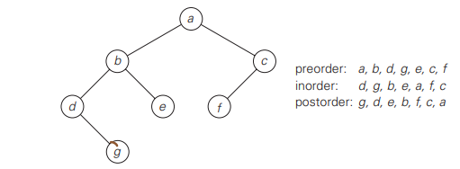
Binary Tree Algorithms
Returning to algorithm Height, the number of comparisons to check whether the tree is empty is
C(n) = n + x = 2n + 1,
and the number of additions is
A(n) = n.

Slide 22
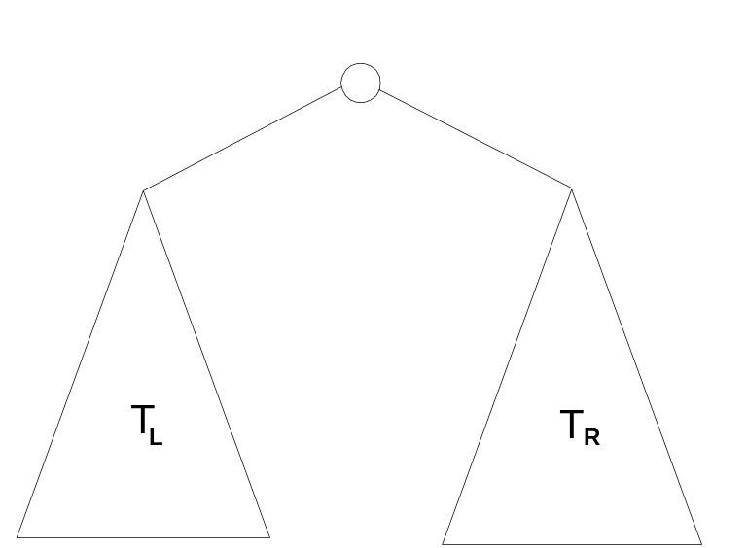
Binary Tree Algorithms (cont.)
Ex. 2: Computing the height of a binary tree
h(T) = max{h(T_{L}), h(T_{R})} + 1 if T ≠ ∅ and h(∅) = -1
Efficiency: Θ(n). Why?

